Slide 1
Sentiment Analysis
- Twitter Comments Datasets Opinion Mining
Presented by: Andrew Xu Date: July 28th, 2023
Vivian Kuang
Emmanuel Nnadi

Slide 2

Agenda
Introduce ML algorithm & application
Popular methodologies
Compare the ML algorithms
Twitter Data EDA
Notebook

Slide 3
ML Algorithm & Application
Sentiment analysis is an approach to Natural Language Processing (NLP) to determine if the emotional tone of the message is positive, negative, or neutral.
Text data like emails, customer support chat transcripts, social media comments, and reviews.
Determine the author’s attitude towards a topic.

Slide 4
ML Algorithm & Application(cont.)
Sentiment analysis to derive intelligence and form actionable plans in different areas:
Improve customer service
Brand monitoring
Twitter Comments
Market research
Track campaign performance

Slide 5
POPULAR METHODOLOGIES
Rule-based
Based on Lexicons, are pre-developed and analyzing semantic and syntactic patterns.
Scans for words in the lexicon and sums up the sentiment score.
ML
Use ML techniques, such as deep learning to identify emotional sentiment from text and train it repeatedly
Hybrid
Combining both ML and rule-based systems.

Slide 6
Algorithms for Sentiment Analysis
Support Vector Machine (SVM)
Naive Bayes (NB)
Logistic Regression
Simplicity
Speed
Low memory usage
Weakness: Independent assumption, low accuracy when features are correlated
Probabilistic interpretation
Simplicity
Low memory usage
Weakness: high-dimensional or non-linear data, accurcy not effective as SVM
High accuracy
Regularization
Kernel trick
Weakness: Complexity and Memory usage
Notes:
Naive Bayes (NB):
Simplicity: Naive Bayes is a simple and easy-to-understand algorithm, making it quick to implement and efficient
Speed: NB is computationally fast and requires relatively little training data to make accurate predictions.
Low memory usage
Weakness: suboptimal performance when features are correlated
Support Vector Machine (SVM):
High accuracy: ability to handle complex decision makes it is effective in high-dimensional spaces like words
Regularization: SVM has regularization parameters that help avoid overfitting by controlling the margin and trade-off between misclassification and simplicity of the model.
Kernel trick: SVM can use different kernel functions to handle non-linear data and improve the performance of the classifier
Weakness: Complexity and Memory usage
Logistic Regression:
Probabilistic interpretation: easier to interpret the confidence in predictions, undstandable
Simplicity: Similar to NB, logistic regression is relatively simple to implement and understand.
Efficiency: computationally efficient, making it suitable for large-scale sentiment analysis tasks
Weakness: high-dimensional or non-linear data, accurcy not effective as SVM

Slide 7
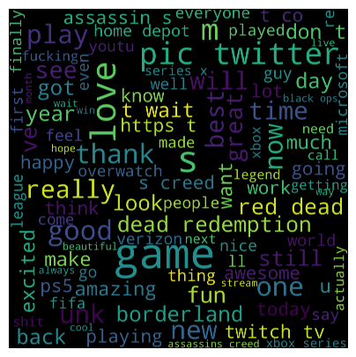
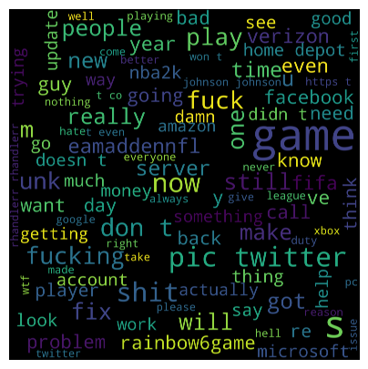

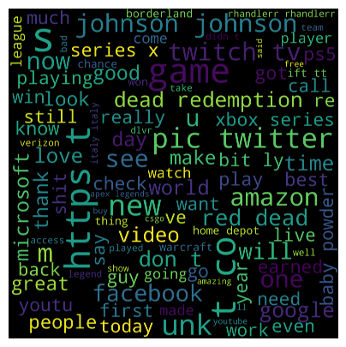
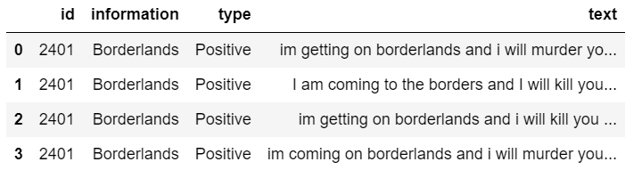
Twitter Data EDA
Training and Validation Datasets
Train: 74682 rows, Validation 1000 rows
4 columns: id, information, type (label), text
686 empty text rows and capital words
4 types of labels: word cloud visualization
word clouds: Positive
word clouds: Negative
word clouds: Irrelevant
word clouds: Neutral

Slide 8
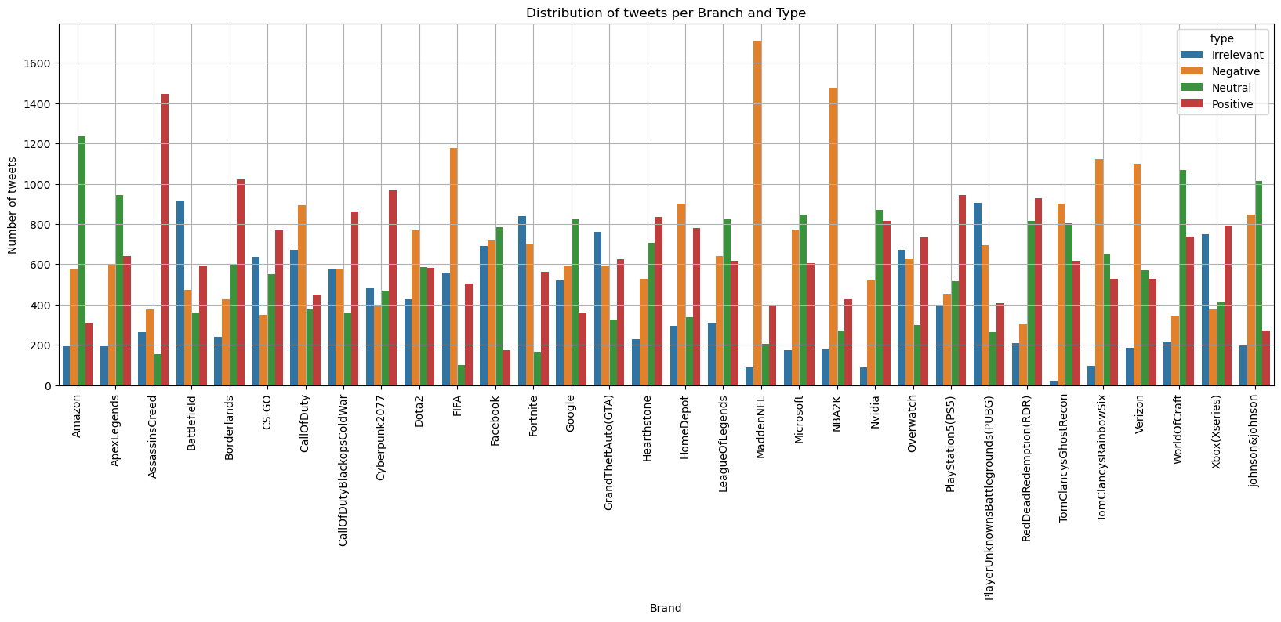
Twitter Data EDA
information column: brands of companies

Slide 9
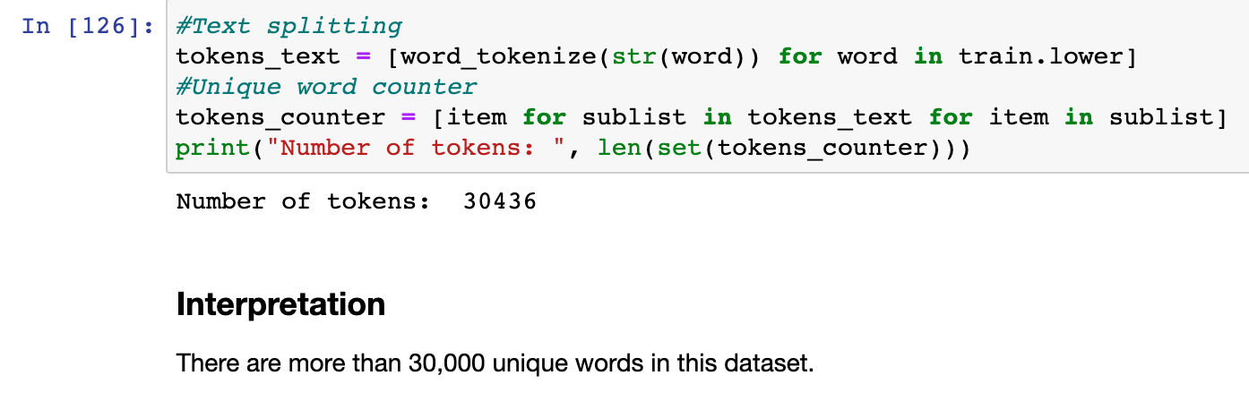
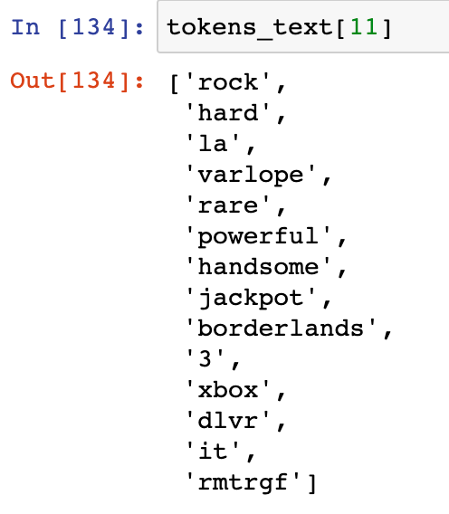
How Much Text Data Are We Dealing With?
Notes:
Talk about how we have to split over 30,000 unique words and how this is

Slide 10
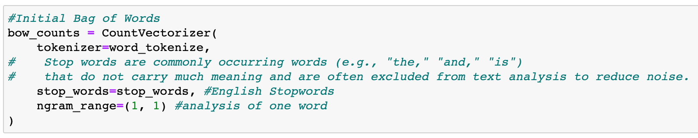
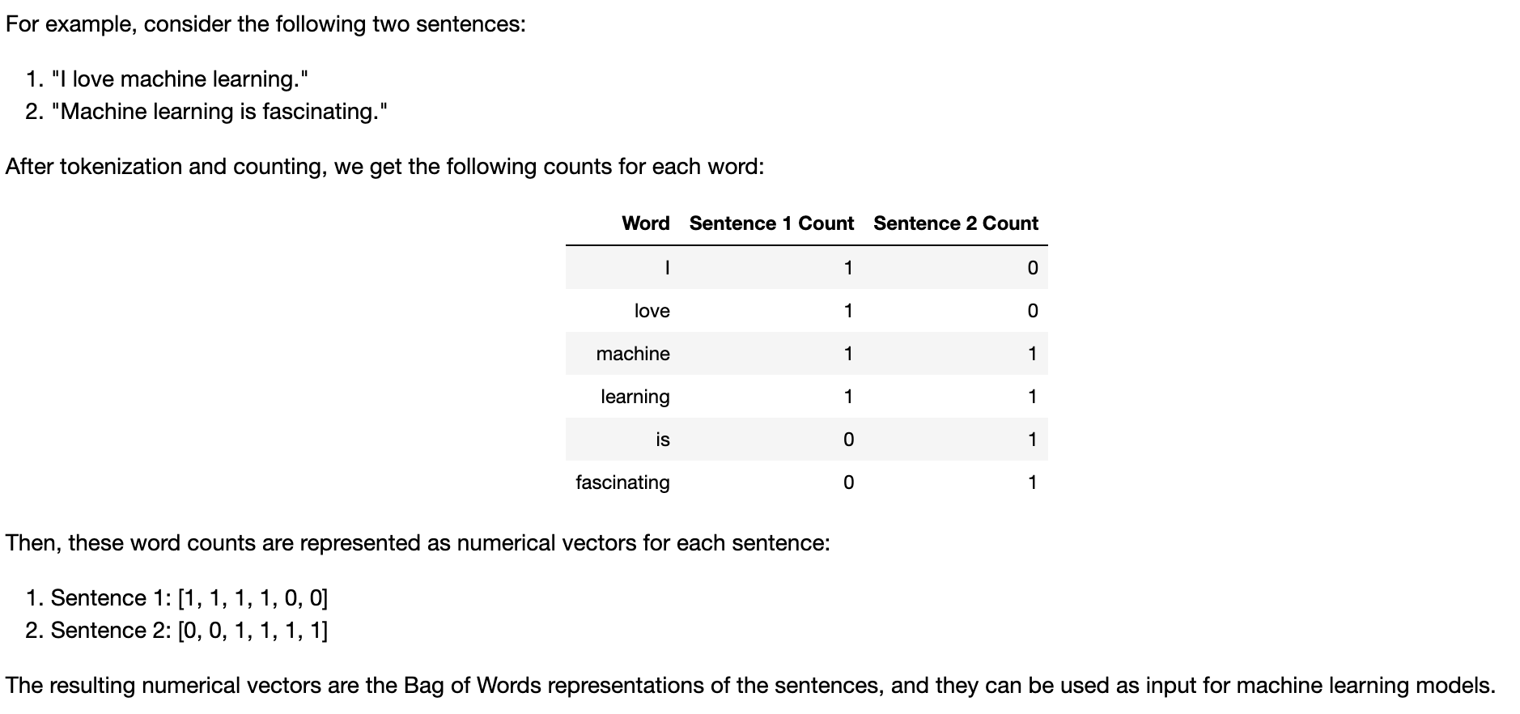
Converting Text to Numeric
Conversion Steps
Text Transformation
Use Stopwords to filter noise
Convert Text to lower with .lower function
This will create new column
Apply Bag of Words(BoW)
Notes:
The CountVectorizer in scikit-learn is a common tool used for converting text data into a bag-of-words representation. By creating this bow_counts object, you can use it to transform text data into numerical vectors representing word frequencies based on the specified configurations (tokenization, stop words, and n-gram range). These numerical vectors can then be used as input for various machine learning algorithms for text analysis tasks.
In this example, the CountVectorizer with tokenizer=word_tokenize transformed the sentences into numerical vectors representing the word frequencies after tokenization and stop words removal. These vectors can now be used for various NLP tasks or fed into machine learning algorithms for analysis.

Slide 11
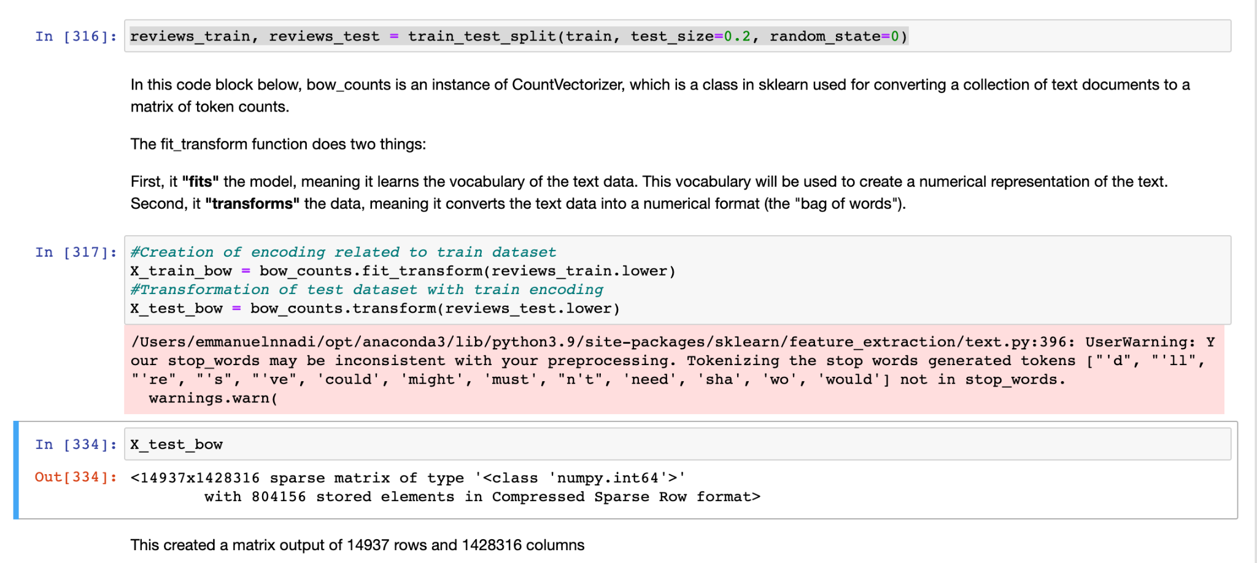
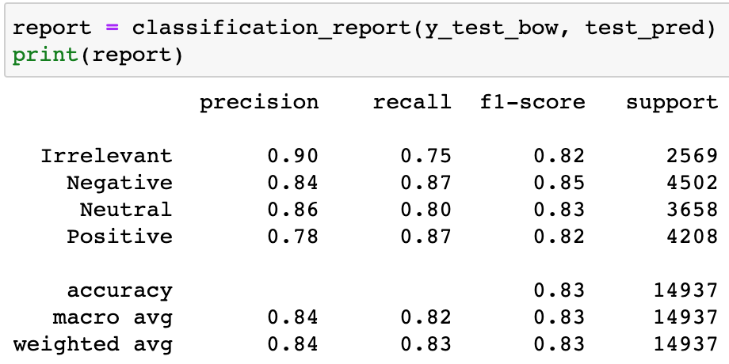
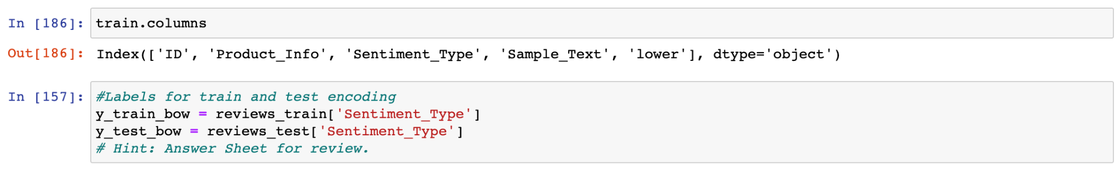
Code Snippet Single Ngram
Notes:
Note that i am using animation to make the scores appear

Slide 12
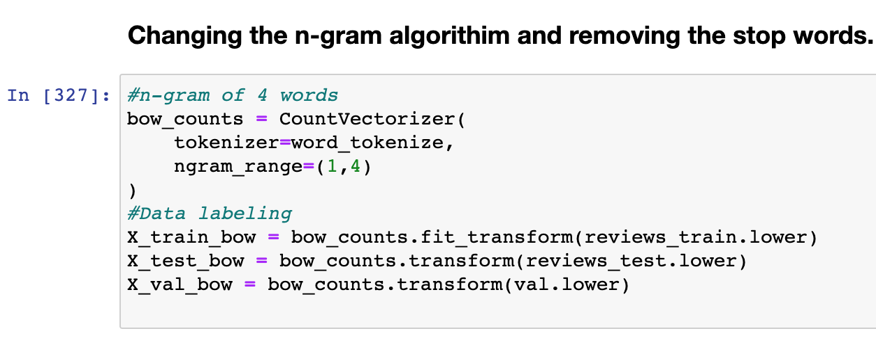
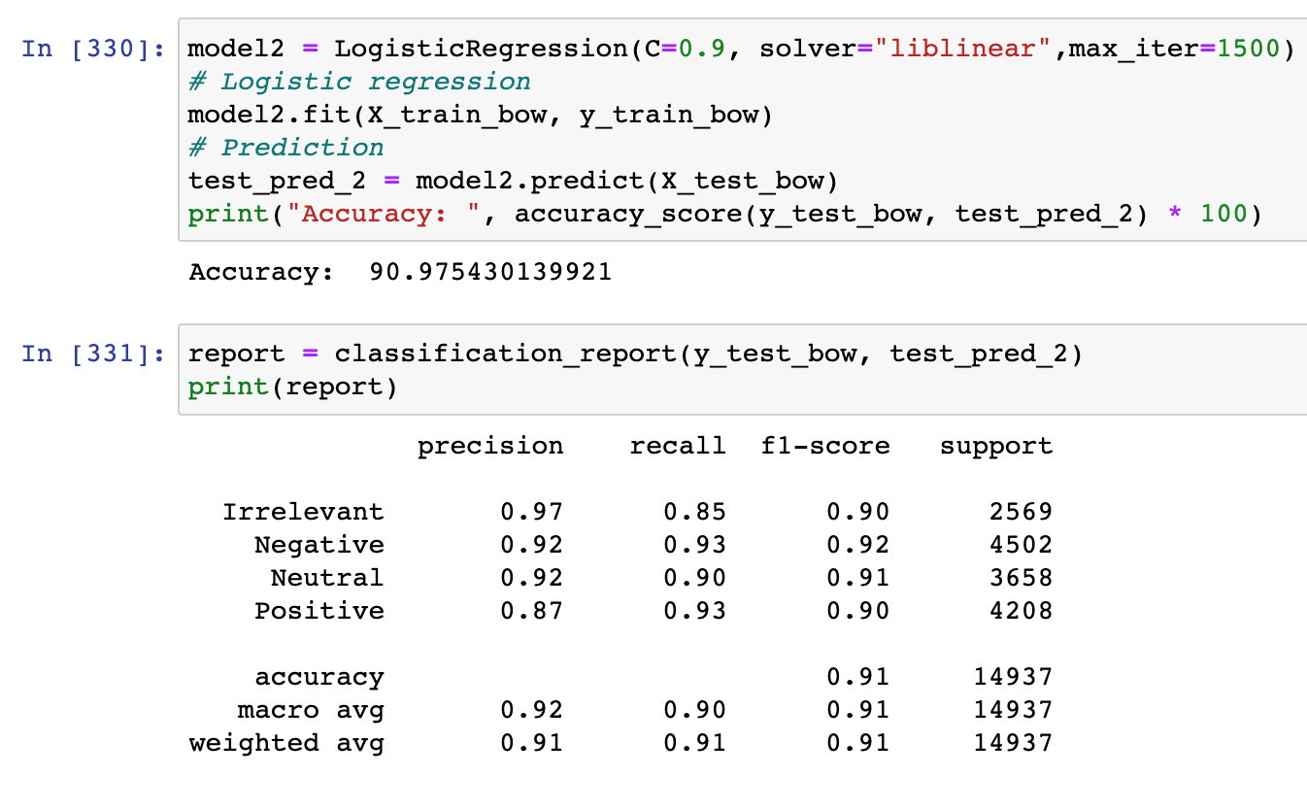
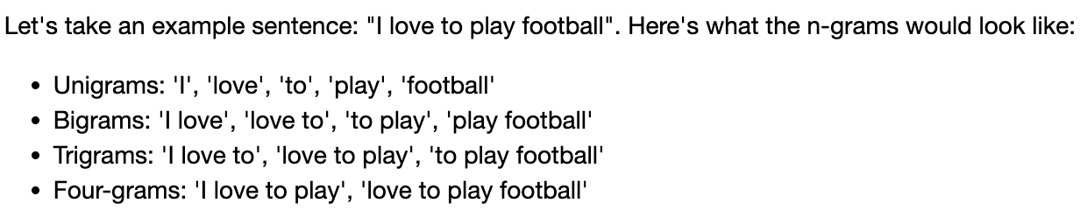
Code Snippet Ngram = 4

Slide 13
Conclusion
The Logistic regression model got: 90 % over Train dataset and the accuracy was 98% on the validation data with parameter max_iter tuned, ngrams tuned.
Useful in the application of Brand Monitoring and general Market feel.

Slide 14
THANK YOU!

